Slide 1

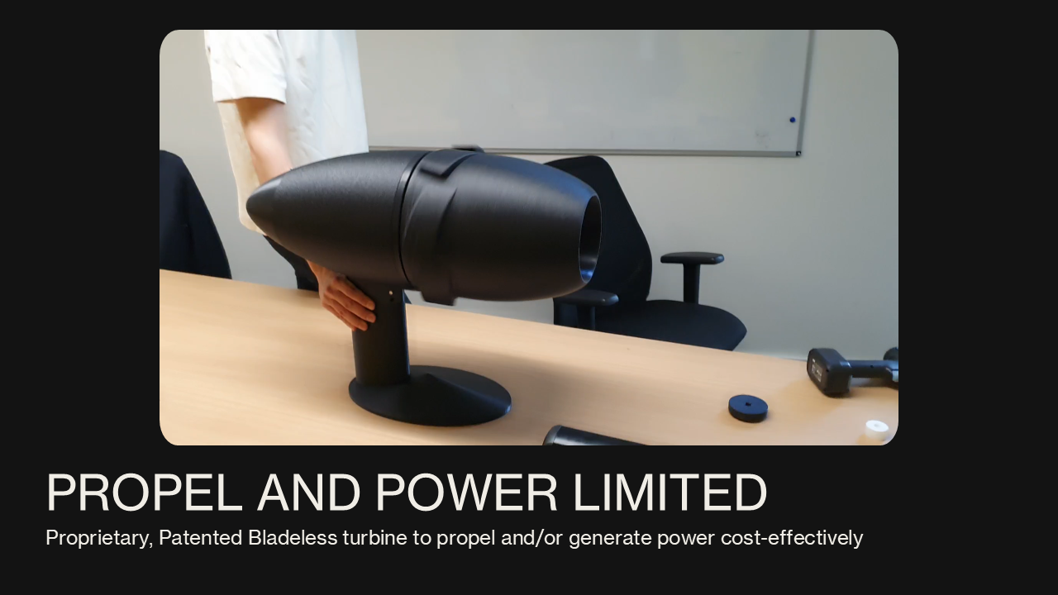
MOBILITY (HORIZON-CL5-2026-06-Two-Stage) Disruptive Technologies and Innovative Concepts for Energy Saving Onboard of long-distance ships (ZEWT Partnership)
Proposed Approach Our solution: The P&P total ZEWT solution is a dual-purpose, bladeless, marine-life-safe turbine that both generates onboard renewable electricity and provides propulsion for long-distance shipping. TRL 4 testing confirms propulsion efficiencies over 25% compared to propellers, while TRL 3 testing indicates the ability to embed turbines within a tubular structure in the hull of the ships to meet full onboard electricity demand. Furthermore, enhanced electricity generation can support Hydrogen production for potential use as hybrid e-Fuels. For cruise ships, this combined solution could reduce GHG emissions by up to 75% compared to the 2008 baseline. Other forms of long-distance shipping would likely see an emissions savings of between 10%-15%. The TOTAL-ZEWT project will pilot the generation capability of embedded turbines (TRL 5) on cruise ships and further validate and prepare the propulsion system for commercial deployment. Results will be modelled and applied across a wide range of vessel types. This work is enabled by strong commercial interest from a major cruise ship operator (TUI), where roughly 50% of emissions come from onboard electricity use. TUI has invested heavily in fuel cells and now seeks renewable onboard generation for electricity use and hydrogen production to further reduce emissions. To this end, they have engaged the innovative turbine developer Propel and Power and are supporting engagement with Naval Architects, Ship Builders and ship designers to deliver the pilot. In parallel, grant funding will advance the propulsion system to full maturity, delivering a holistic ZEWT solution by the end of the project. | Organisational Capabilities: The company is a startup with capabilities in the development of highly efficient bladeless turbines for both generation and propulsion services. Ongoing engagement with the TUI Cruises Partner Type: SME Partnership sought: Project Lead/Coordinator with expertise and focus in Maritime Decarbonisation, Deployment onboard ships, Testing, Integration with Ship Electrical systems Others: RISE, MARIN, CMMI
Experience: Turbine system provides predictable renewable energy for ship propulsion, onboard electricity generation, Power for eFuels, terminal equipment electrification, and hinterland connectivity — reducing reliance on fossil-based grid imports and diesel generators. The turbines are currently at TRL 3 for propulsion and 5 for generation. Partners we can engage: Commercial Partner: TUI Cruises Technical Coordinator: Jura Advisory Services Ship builder and Naval Architect: Fincantieri (Being approached) Gearbox and Generators: involution Technologies AI based monitoring: EcoDetect Other key partners will be brought in by TUI Cruises but are welcome to apply independently as well | Administrative Information Role: Partner Contact details: Jagadish Rao Raghavendra, FT NED Dipl. jrrao@propelandpower.com +44 7921 462171 Location: 482A, Warwick Road, Solihull, B91 1AG, UK
Notes:
Replace the italics with your input

