Slide 1

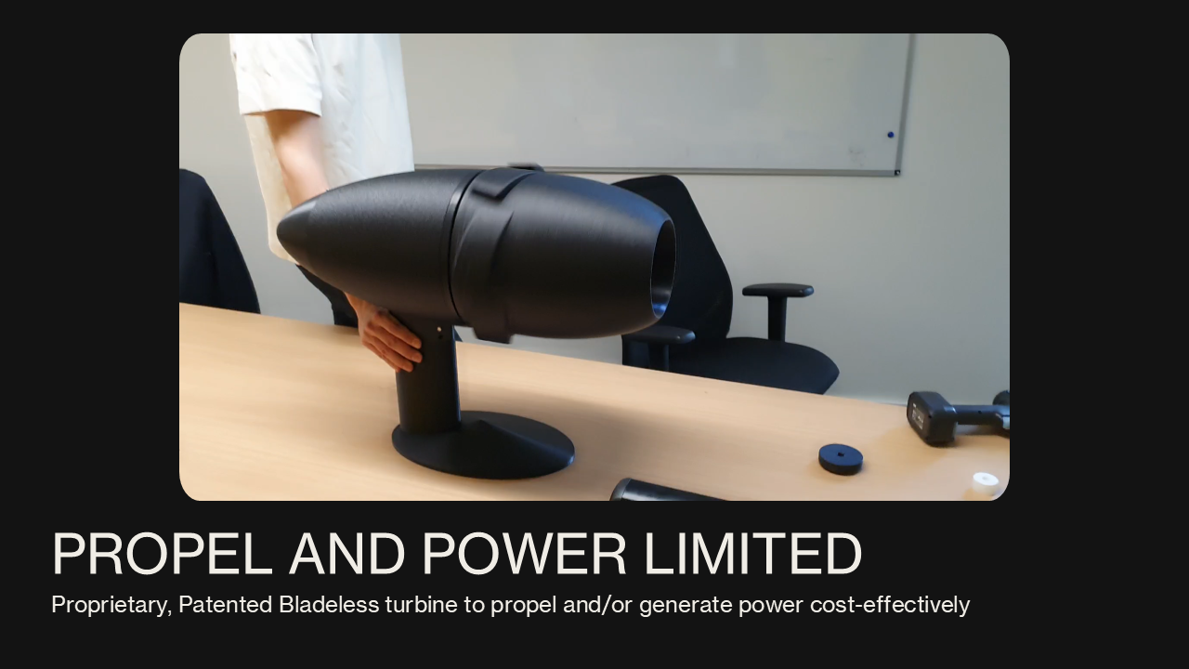
HORIZON‑CL5‑2026‑05‑D5‑11 (ZEWT Partnership): Marine‑Safe, AI‑Enabled Tidal Energy Systems for Zero‑Emission, Climate‑Resilient Ports of the Future
Proposed Approach The problem we solve: The need for marine safe renewable generation. Scope in this Grant: Objective 3 : “Design and demonstrate integrated smart energy systems and grids for port and waterborne transport operations, including energy production, storage and OPS operations” Our solution: PROPEL AND POWER LIMITED proposes progressive development to a TRL 8 demonstration of a bladeless, marine-safe tidal energy system designed to provide continuous, zero-emission clean power for small and medium sized ports across Europe. The team will demonstrate its ability to: Reduce GHG, air, and water pollutants, Improve biodiversity protection, Strengthen climate resilience, Enable digital, data-driven port operations. The system provides predictable renewable energy for port operations, onshore power supply (OPS), Shore-to-Ship power, Anchorage-to-Ship power, Power for eFuels, terminal equipment electrification, and hinterland connectivity — reducing reliance on fossil-based grid imports and diesel generators. The PROPEL & POWER system integrates: Bladeless tidal turbines using stagnation water hydrodynamics to naturally deflect marine life Upstream protective netting and AI enabled cameras for continuous biodiversity monitoring Digital twin integration for real time optimisation of energy production, storage, and OPS loads Modular seabed or quay-mounted configurations suitable for small and medium-sized ports with good tidal currents Smart grid connectivity enabling integration with port microgrids, EV charging, and terminal equipment The system is biodiversity friendly, low-maintenance, and scalable, enabling ports to adopt clean energy without requiring large land footprints or major infrastructure upgrades. objectives | Organisational Capabilities: The company is a startup with capabilities in the development of highly efficient bladeless tidal turbines. Beyond this the company can support the oversite of the organization and placement of upstream protective netting and enabled cameras for continuous biodiversity monitoring. Digital twin development and integration for real-time optimisation. Modular seabed or quay-mounted configurations suitable for small and medium sized ports. Support with smart grid connectivity. Ongoing engagement with the Ports of ESBjerg and Port of Aberdeen,. Partner Type: SME Partnership sought: Project Lead/Coordinator already having partnership with TEN-T ports
Experience: Turbine system provides predictable renewable energy for port operations, onshore power supply (OPS), Shore-to-Ship power, Anchorage-to-Ship power, Power for eFuels, terminal equipment electrification, and hinterland connectivity — reducing reliance on fossil-based grid imports and diesel generators. The turbines are currently at TRL 5. Partners we can engage: Commercial Partner: Port of Aberdeen, Port of Esbjerg (in discussion) Finance and business model development: Jura Advisory Services Gearbox and Generators: involution Technologies Research and Technology Organisations: Cranfield University Catapults: MTC, CPI, OREC Microgrid: Schneider Electric Certification and Validation organisations: Orcades Marine AI based monitoring: EcoDetect | Administrative Information Role: Partner Contact details: Jagadish Rao Raghavendra, FT NED Dipl. jrrao@propelandpower.com +44 7921 462171 Location: 482A, Warwick Road, Solihull, B91 1AG, UK
Notes:
Replace the italics with your input

