Slide 1









CLARA - Center for Artificial Intelligence and Quantum Computing in System Brain Research
Vít Dočkal, CLARA Interim Director
Česko-slovenský infodeň: TEAMING 2025
November 20, 2024
In collaboration with

Slide 2

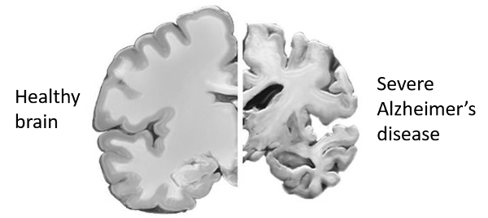
CLARA Motivation
Contribute to finding effective treatment to Alzheimer’s disease and other neurodegenerative diseases
Alzheimer’s disease: $1.1 trillion in healthcare costs by 2050
7th leading cause of death globally
No efficient drugs available to date
1. WHO Report (2019), The top 10 causes of death
Image credit: US National Institute on Aging; Mookyung et al. 2015
Notes:
- The main motivation of the project is to contribute to finding effective treatments for Alzheimer's disease and other neurodegenerative diseases.
- Alzheimer's disease is a growing problem burdening the healthcare system and is currently the 7th most common cause of death in the world.
- Despite this severity and the huge and growing healthcare costs, there are still no sufficiently effective drugs approved today.
1:32min.

Slide 3
CLARA Vision
CLARA Vision
CLARA strives to address the grand challenge of vitality and longevity of neurons>
What are the necessary and sufficient conditions to maintain optimal function, vitality and longevity of a neuron to exceed 100 years?
Notes:
The ambition of the project is to push the frontier of neurodegeneration research
By addressing its grand challenge :
What are the necessary and sufficient conditions to maintain optimal function, vitality and longevity of a neuron to exceed 100 years?
This is a truly interdisciplinary project combining clinical neuroscinece molecular biology, high-perfocmance computing and quantum computing together with AI and machine learning to answer this question.
This interdisciplinary collaboration will enable new research into on, for example, energetics and metabolism in neurons and whether the are critical factors in neurodegenerative disease progression and as novel targets for therapeutic interventions.
====================
examine the interactions between the molecular, behavioral and clinical features of brain disorders through the integration of quantum computing (QC) and high-performance computing (HPC,) with AI/ML
[With the goal to better understand, visualize and simulate the optimal performance of a neuron and the underlying biochemichal mechanisms. ]
This new knowledge will allow for innovative research into how, for example, energy disruptions are critical factors in neurodegenerative disease progression and as novel targets for therapeutic interventions.

Slide 4
CLARA Focus
Builds an interdisciplinary center of excellence
Develops the next generation of artificial intelligence / machine learning and classical / quantum-centric supercomputing tools
To power interdisciplinary research programs aimed at understanding the causes of neurodegenerative diseases and neuron longevity.
Notes:
- In summary, CLARA aims to build an interdisciplinary center of excellence.
- That will develop the next generation of AI L and supercomputing tools
- To power interdisciplinary research programs aimed at understanding the causes of neurdegenerative diseases.

Slide 5
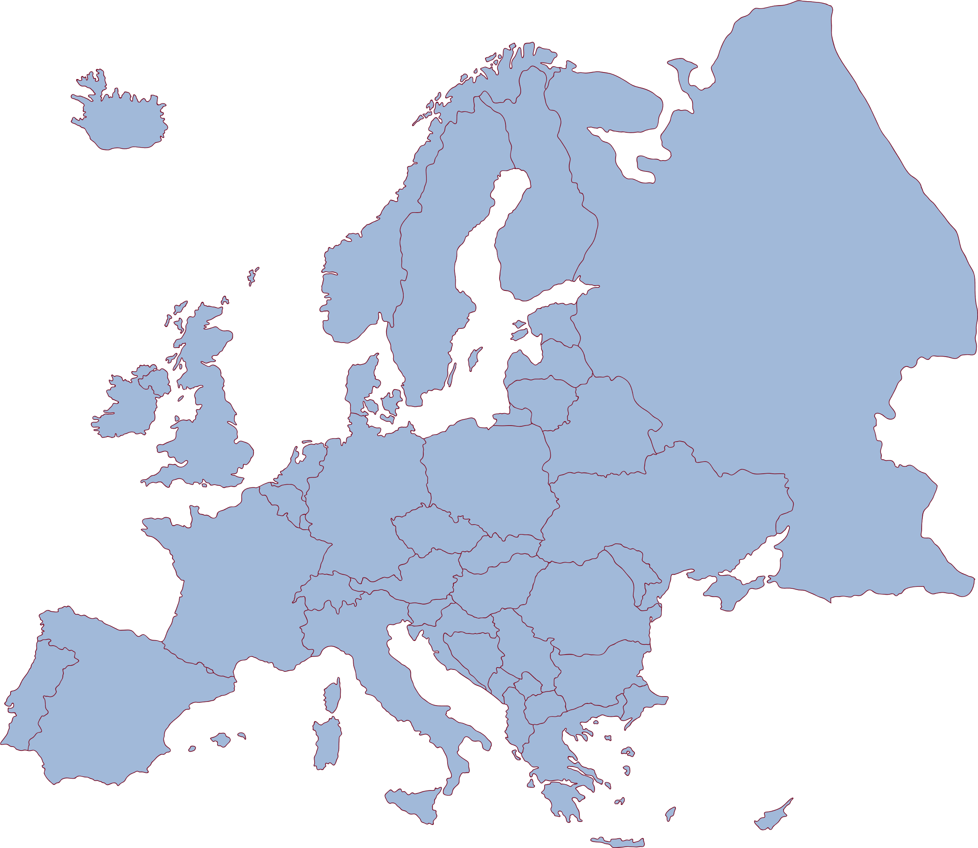







CLARA Partners
CLARA
Opening
Ceremony
13 Nov
2024
Prague
CLARA Partners

Slide 6

CLARA Differentiators
EXCELLENCE FAR BEYOND THE STATE OF THE ART
  Excellent consortium
  Interdisciplinary by design. QL, HPC, AI, protein engineering, clinical research, SSH.
CLEAR NEED FOR CLARA
  Several levels: EU priority, CZ priority, benefit for the widening countries, (cohesion), benefits for all partners, respective regions, EU society and economy.
SUSTAINIBILITY
  Sound sustainability financial plan and strategy (starts Day 1)
AUTONOMOUS AND TRUSTED GOVERNANCE
  Coordinator = private non-profit organization. Partnership based on transparent legal set up and friendship.
………

Slide 7
CLARA summary
Project name | Center for Artificial Intelligence and Quantum Computing in System Brain Research
Acronym | CLARA
ID code | 101136607 – call: HORIZON-WIDERA-2023-ACCESS-01 CZ.02.01.01/00/23_029/0008437 - OP JAK (in the approval process)
Duration | 11/2024 – 10/2030 (72 months/ 6 years)
Total Budget | 43 mil. EUR: Horizon Europe: 15 mil. EUR OP JAK: 28 mil. EUR (in the approval process)
Consortium | Czech Republic: INDRC – International Neurodegenerative Disorders Research Center (Coordinator) CIIRC CTU – Czech Institute of Informatics, Robotics and Cybernetics CTU in Prague VSB-TUO – Technical University of Ostrava ICRC – International Clinical Research Center, St. Anne’s University Hospital Brno PBI - Paris Brain Institute, France LRZ – Leibniz Supercomputing Centre, Bavarian Academy of Sciences and Humanities, Germany

Slide 8
Acknowledgement
CLARA - Center for Artificial Intelligence and Quantum Computing in System Brain Research.
This project has received funding from the European Union's Horizon Europe Framework Programme under Grant Agreement No. 101136607.
An application for support of the project Centre for Artificial Intelligence and Quantum Computing in Brain Systems Research (CZ.02.01.01/00/23_029/0008437) from the European Union and the Czech Republic within the framework of OP JAK has been submitted and is currently in the process of approval.

