Slide 1


Teaming 2023 - 2024 call outcomes, FAQs and evaluators´ comments
Anna Vosečková, NCP WIDERA, NCP EIT
CZ-SK webinar on TEAMING 2025 call
20 November 2024, Bratislava and Prague

Slide 2
TEAMING for excellence
CALL 2023-2024 OUTCOMES

Slide 3

overview
HORIZON-WIDERA-2023-ACCESS-01-01
Opening: 10 January 2023
Deadline 1st stage: 12 April 2023
Deadline 2nd stage: 7 March 2024
Overall indicative budget: M€ 174
Budget per project: M€ 8 – 15
Project duration: up to 6 years
Consortium: minimum 1 + 1
Expected no. of projects: 18

Slide 4
TEAMING STAGE 1

Slide 5
Scoring
The threshold for both criteria is 4.
The overall threshold (applying to the sum of the two individual scores) will be set for the call at a level that allowed the total requested budget of proposals admitted to stage 2 be as close as possible to 3 times the available budget (and not below 2.5 times the budget):
  HORIZON-WIDERA-2023-ACCESS-01-01-two-stage Teaming for Excellence (Stage 1): 8.5 points
GENERALISED FEEDBACK AFTER STAGE 1
In order to best ensure equal treatment, successful stage 1 applicants do not receive the evaluation summary reports (ESRs) for their proposals, but this generalised feedback with information and tips for preparing the full proposal.

Slide 6
Number of Projects in TEAMING STAGE 1
Submitted 125 (2 ineligible)
Evaluated 123
Main list 35 (threshold 8,5)
Below threshold 88
No reserve list at Stage 1
ESR only for rejected proposals
SCORE OF RETAiNED PROJECTS |  | SCORE OF REJECTED PROJECTS
NO. OF PROJECTS | SCORE | NO. OF PROJECTS | SCORE
3 | 10 | 1 | 8,5
3 | 9,5 | 17 | 8
12 | 9 | 10 | 7,5
17 | 8,5 | 18 | 7
 |  | 16 | 6,5
 |  | 11 | 6
 |  | 10 | 5,5
 |  | 3 | 4
 |  | 2 | 3

Slide 7
PROJECT COORDINATORS – after STAGE 1

Slide 8
TEAMING STAGE 2

Slide 9
Number of Projects in TEAMING STAGE 2
Submitted 34 CZ 4 SK 1
Evaluated 33
Evaluators 5 per project
Main list 12 (12.5 points min.) CZ 1
Reserve list 3 SK 1 (recently moved to the main list)
Funded projects 13 CZ 1 SK 1
Below available budget 13 CZ 3
Below threshold 5
Project duration 72 months
Lowest project budget 9 000 000 €

Slide 10
TEAMING STAGE 2 PROJECTS SCORING
RETAINED |  | RESERVE LIST |  | BELOW AVAILABLE BUDGET |  | BELOW THRESHOLD
PROJECTS | SCORE | PROJECTS | SCORE | PROJECTS | SCORE | PROJECTS | SCORE
3 | 14, | 2 | 12 | 2 | 12 | 2 | 9,5
2 | 13,5 |  |  | 3 | 11,5 | 1 | 8,5
2 | 13 |  |  | 1 | 11 | 2 | 8
5 | 12,5 |  |  | 2 | 10,5
1 | 12 |  |  | 4 | 10

Slide 11
participants in teaming 2023 call – stage 2 (154 IN TOTAL,
55 on the main list) (IN ALPHABETIC ORDER)

Slide 12
PROJECT COORDINATORS – STAGE 2

Slide 13
Teaming 2024 funded projects
ACRONYM | TITLE | PANEL | COUNTRY
PMPC | Centre of Excellence for Precision Medicine in Pediatric Care | MED | LV
TRIO-VI CoE | Translational Research and Innovation in Ophthalmology Vision - CoE | MED | CY
CLARA | Center for Artificial Intelligence and Quantum Computing in System Brain Research | MED | CZ
QSciTec | Center of Excellence in Quantum Computing for Science and Technology | MAT | CY
INESCTEC.OCEAN | Centre of Excellence in Ocean Research and Engineering | ENV | PT
CELESTE | Cutting Edge Leap to Excellence in Space and Optics TEchnologies | ENG | ES
H2START | Green Innovations in Hydrogen for Sustainable Energy Transition | PHY | BG
HERON | HERON Center of Excellence in Robotics | ENG | EL
MARBLE | CoE in Maritime Robotics and Technologies for Sustainable Blue Economy | ENG | HR
TEAM-NANO | Teaming for Capacity Development and Synergies in Micro-nanofabrication and Flexible Electronics for Widespread Impact | ENG | TR
Astrocent Plus | Astrocent Plus -- Particle Astrophysics Science and Technology Centre | ENG | PL
P4Health | Centre of Excellence for Precise Phenotyping and BioDataBanking | MED | PL
lorAI | Low Resource Artificial Intelligence | MAT | SK

Slide 14
Frequently asked questions

Slide 15

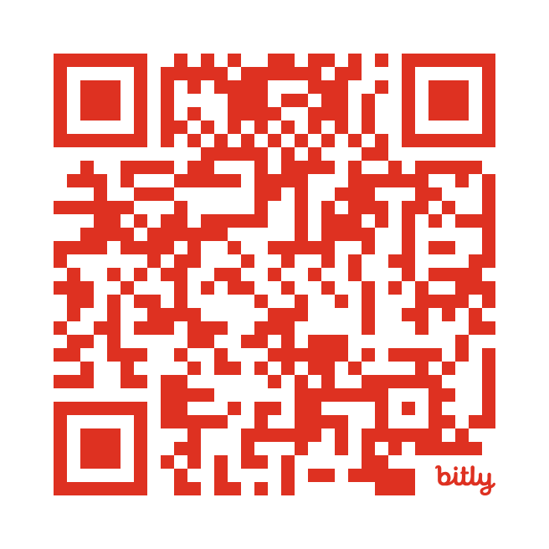
comprehensive document with TEAMING 2025 Frequently asked questions (FAQs)
not published at TEAMING 2025 call web page on FTOP as the call is not open yet
currently to be found at the TEAMING 2023-2024 call but EC updated them in August 2024

Slide 16
Main shortcomings after stage 1
GENERALISED FEEDBACK ON FTOP FOR SUCCESSFUL PROJECTS

Slide 17
EXCELLENCE (1)
STRATEGIC VISION
CHALLENGES
too broadly defined, scope and ambitions too wide-reaching and insufficiently focused
state-of-the-art not suitably referenced; advancement beyond the state-of-the-art not convincingly demonstrated
novel and innovative aspects not sufficiently highlighted
approaches to achieving the stated goals not properly defined
specific challenges for both the research discipline and/or the region not fully discussed
some proposals address either scientific or operational challenges, but not both
HUMAN RESOURCES
staff recruitment and retention approaches not appropriately addressed
lack of concrete and attractive incentives to recruit and retain staff

Slide 18
EXCELLENCE (2)
AUTONOMY
OBJECTIVES
decision-making mechanisms, distribution of responsibilities, management bodies and independence from existing structure(s) not adequately addressed
measurability of the objectives often not assured
no or insufficient number of suitable indicators (KPIs) to verify achievement
objectives not sufficiently linked to subsequent actions and activities
SYNERGIES
PARTNERSHIP
existing or potential synergies with EU/national/regional funds and policies not clearly or sufficiently identified
no adequate description of how projects will work with or add value to policy instruments
interaction and mutual benefits between coordinator and advanced partner(s) not always appropriately described
engagement and commitment of the advanced partner(s) not fully demonstrated

Slide 19
IMPACT
REQUIREMENTS, BARRIERS, MITIGATIONS
inadequate analysis of barriers to impact achievement
lack of well-defined and robust mitigation measures
LONG-TERM SELF-SUSTAINABILITY
insufficiently convincing plans for long-term sustainability
insufficient leverage of business opportunities / IP exploitation

Slide 20
Most frequent evaluators´ comments
STAGE 1 UNSUCCESSFUL PROJECTS

Slide 21
excellence
proposal does not
  provide enough detail in its description, making it difficult to assess its real strategic vision and credibility
  describe with credible and concrete references how the complementary funding would be obtained
  adequately describe how the autonomy of the CoE will be achieved
way of achieving objectives is not clearly supported by a review of the state of the art
synergies with national funding and strategies are not described in adequate detail
human resources and recruitment issues are not adequately addressed
ambition of the proposal is modest, both in the objective of creating a CoE and in the economic needs and partners

Slide 22
impact
proposal does not address in sufficient depth or width limited ambition the growth of the CoE activity
adequate measures of socio-economic outreach are not clearly presented.
planned impact on the national R&I environment of the host country and local region has not been elaborated in sufficient data
proposal does not clearly explain the impact at institutional and national level of the results expected from the implementation of the CoE.
relevant vision concerning long-term sustainability of the Centre of Excellence is not fully described

Slide 23
Most frequent evaluators´ comments
STAGE 2 UNSUCCESSFUL PROJECTS

Slide 24
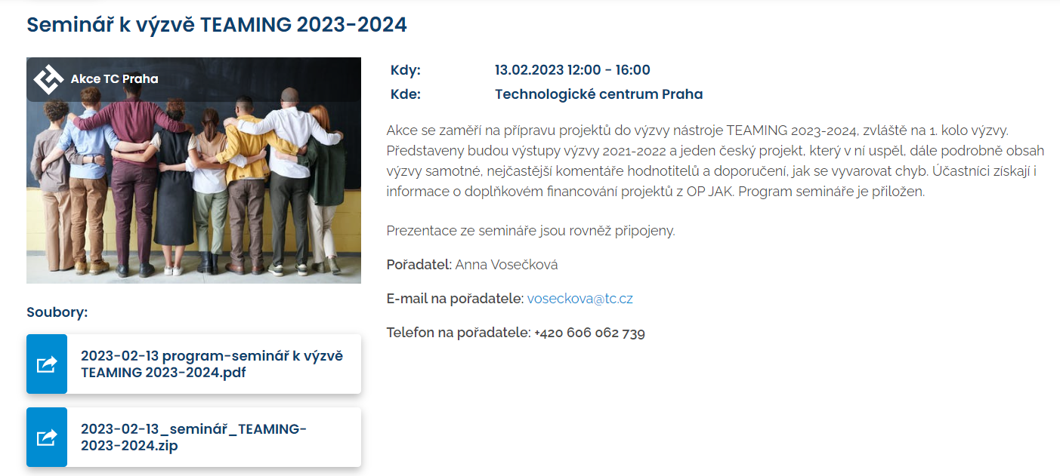


Slide 25
Important issues

Slide 26

Teaming stage 1
Proposal form CSA stage 1: Part B - 10 pages
SPECIFIC TEMPLATE FOR TEAMING STAGE 1
  1. Excellence
  1.1 Objectives (2 pages)
  1.2 Coordination and/or support measures
  and methodology (5 pages)
  2. Impact
  2.1 Project’s pathways towards impact (3 pages)
NO budget table in stage 1, only Total requested grant amount

Slide 27
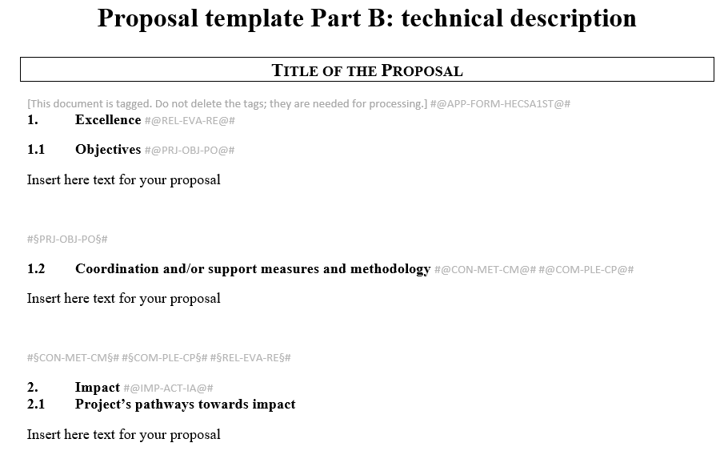
STAGE 1 - PART B

Slide 28

Administrative forms – part a

Slide 29
Questions?
Anna Vosečková
WIDERA NCP, EIT NCP
+420 606 062 739
voseckova@tc.cz
www.tc.cz

